Slide 1

PatientHero: Simplifying Appointment Bookings
Leveraging AI for Seamless Healthcare Access

Slide 2

Introduction
This presentation outlines PatientHero, an innovative solution designed to simplify the process of booking medical appointments. By utilizing AI technology, we aim to alleviate the common frustrations faced by patients when seeking timely healthcare services.

Slide 3

01
Inspiration

Slide 4

Headache of Booking Appointments
Many patients struggle with the tiring process of finding available appointments while feeling unwell.

Slide 5
Online Appointment Challenges
The hassle of browsing multiple clinic websites complicates the booking process for patients in need.

Slide 6
Importance of Streamlined Processes
A simplified and efficient system is crucial for enhancing patient experiences in healthcare access.

Slide 7
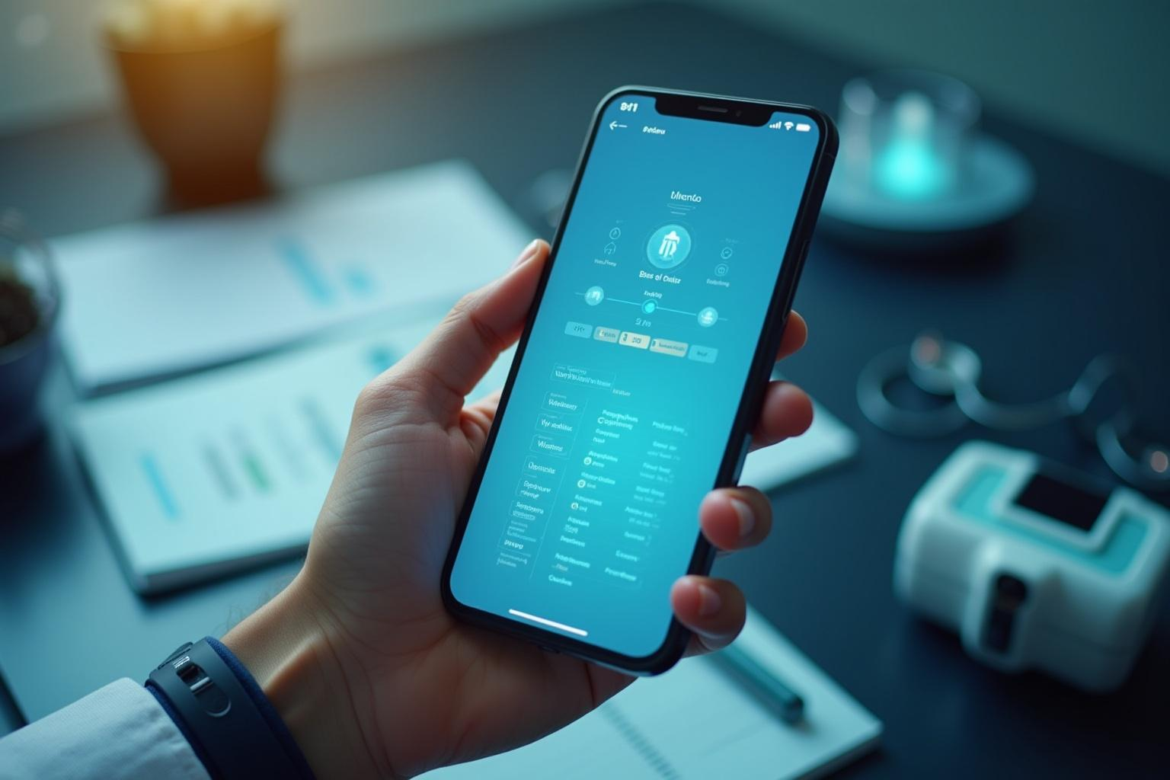
02
Application Overview

Slide 8
AI Chat Functionality
Our application engages patients in conversation to assess their symptoms with an AI agent.

Slide 9
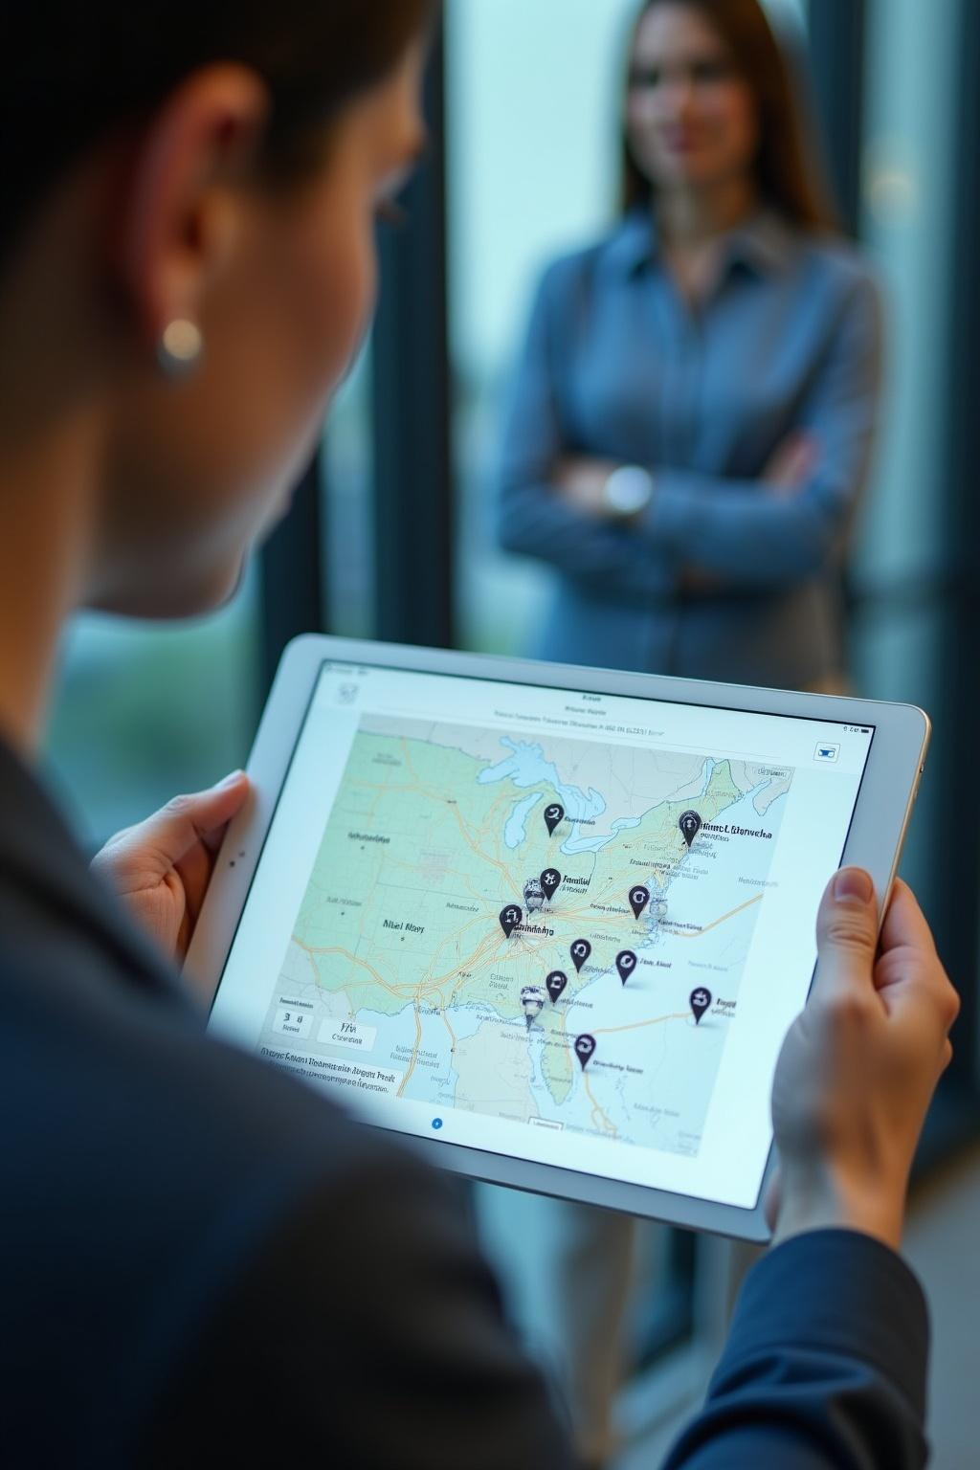
Location-Based Appointment Scanning
Simultaneously, it checks nearby clinics for available appointment slots based on the patient's location.

Slide 10
Integration of Multiple AI Agents
The system utilizes different AI agents to provide advice and browse clinic availability effectively.

Slide 11

03
Development Process

Slide 12
Dialogue with Patients
Interactive dialogues are crucial for understanding patient needs and symptomology.

Slide 13

Use of AI Technologies
We employed advanced AI technologies:
CrewAI - Agents chatted with the patient, managed the Browserbase threads
Gemini - Triaged the patient, giving immediate support
Exa.AI - Searched for local clinics
Browserbase - Parallelized the search for appointments
Weave - Traced the LLM interactions, watching for PII, triggering the Safety Guardrail, critical for this application!

Slide 14
Monitoring for PII Data Flows
We implemented Weights & Biases
Weave to leverage monitoring protocols to ensure that patient information is handled securely and adheres to privacy regulations. This system provides oversight for data flows, safeguarding sensitive information throughout the appointment booking process.

Slide 15

04
Challenges Encountered

Slide 16
Integration Issues
We faced technical challenges integrating various AI systems, which initially slowed down our progress.

Slide 17
Website Heterogeneity
The differing structures and interfaces of clinic websites complicated our automated scanning process.

Slide 18

Learning Curve and Adaptation
Our team had to quickly adapt to new technologies and overcome a steep learning curve to achieve successful implementation.

Slide 19

05
Achievements

Slide 20
Team Collaboration
Two engineers, despite their initial unfamiliarity, successfully collaborated to build a cohesive application flow.
- Harshal Hirpara
- Ashish Patel

Slide 21

Successful Modeling of Application Flow
The team achieved a robust model of the application that meets user needs efficiently and effectively.

Slide 22
Compromises and Innovations
Through collaboration, we made necessary compromises while fostering innovative solutions to enhance our project.

Slide 23

06
Future Directions

Slide 24
Leveraging Insurance Information
Future updates will include utilizing patients' insurance details to narrow down clinic options.

Slide 25
Enhancing Appointment Booking
We aim to streamline the appointment booking process further, providing a more user-friendly experience.

Slide 26

Continuing Natural Language Processing Improvements
Continuous enhancements in natural language processing will improve interactions and support better patient guidance.

Slide 27

Conclusions
PatientHero provides an innovative solution to simplify appointment bookings, addressing common patient frustrations while ensuring data privacy. Through collaboration and technology, we empower patients in their healthcare journey.

Slide 28
Thank you!
Do you have any questions?
+00 000 000 000

